Slide 1
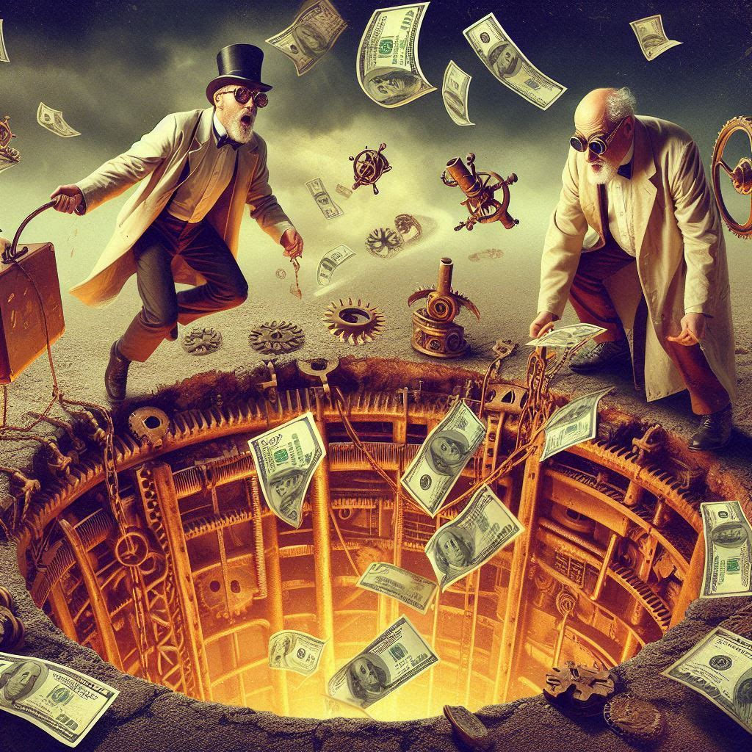

Physics Critique
Particle Physics Funding Prioritization
Notes:
Hi. Welcome to this episode of Emergent Nature.
My name is J Mark Morris. I go by Mark.
In this episode I’ll discuss the error that caused science to go off track into general relativity and quantum mechanics.
That may seem like an unusual thing to say, since general relativity and quantum theory are generally considered to be successful effective theories.
However, as we will see, an error circa 1900 threw science off track.
There is a parsimonious solution to nature.

Slide 2
Physics Critique 1
P5 Report of the 2023 Particle Physics Project Prioritization Panel
Notes:
Hi. Welcome to this episode of Emergent Nature.
My name is J Mark Morris. I go by Mark.
In this episode I’ll discuss the error that caused science to go off track into general relativity and quantum mechanics.
That may seem like an unusual thing to say, since general relativity and quantum theory are generally considered to be successful effective theories.
However, as we will see, an error circa 1900 threw science off track.
There is a parsimonious solution to nature.

Slide 3

Welcome to the Emergent Nature channel.
Here we discover and learn how nature and the universe emerge from minimal ingredients.
The missed opportunity 125 years ago circa 1900
The new architectural hypothesis and mapping to the current GR/QM/LCDM era.
A new sensible narrative
For those of you who are participating in the “You Can Solve Nature and the Universe” series, this video will contain spoilers that reveal portions of the architecture that you could very well discover yourself with a few clues.
Notes:
I’m Mark

Slide 4
This video
In this video I’ll discuss and review a recent report from the physics and cosmology communities that aims to align and justify their strategic vision with their future U.S. Budget funding levels.
I’ll do my best to explain three perspectives.
my understanding of the consensus community view
the view from concerned professionals in the field and critics of the field
the view from the next era in physics and cosmology, looking backward
Notes:
I have many issues with this report and the recommendations. and I see it as a tragic effort at the end of the GR/QM era. The Pollyanna theme throughout doesn't recognize the poor return on investment for their funding. It is also evident that the "leadership" in the field squeezes the pay of the people in academia while trying to maximize "progress". Whatever "progress" is optimized for at the moment. The report is oblivious to this well-known dissatisfactory issue for many people in various stages of advancement in physics related fields. This should be a central issue in the report. The field should rise above predatory compensation. Why is this not discussed? The bottom line is that no one is being honest about the ROI. It sucks. This has resulted in adaptive behaviour which disadvantages the people in the field. The field needs to take the L and figure out what happened. The scientific method does not offer anything but laissez-faire platitudes about self-correction. The scientific method does not have any proactive detection for a crisis in the ontology that may have occurred long ago. Was there a missed opportunity during the classical to quantum transition? How many geometric point charge systems can you imagine? How many were falsified? Model #00000000001 where -q = electron, +q = proton was falsified. Ok, so what? That is your clue.

Slide 5
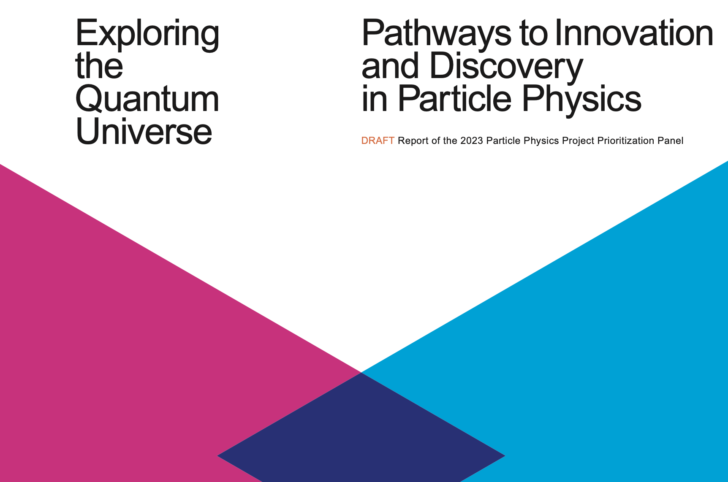

Slide 6
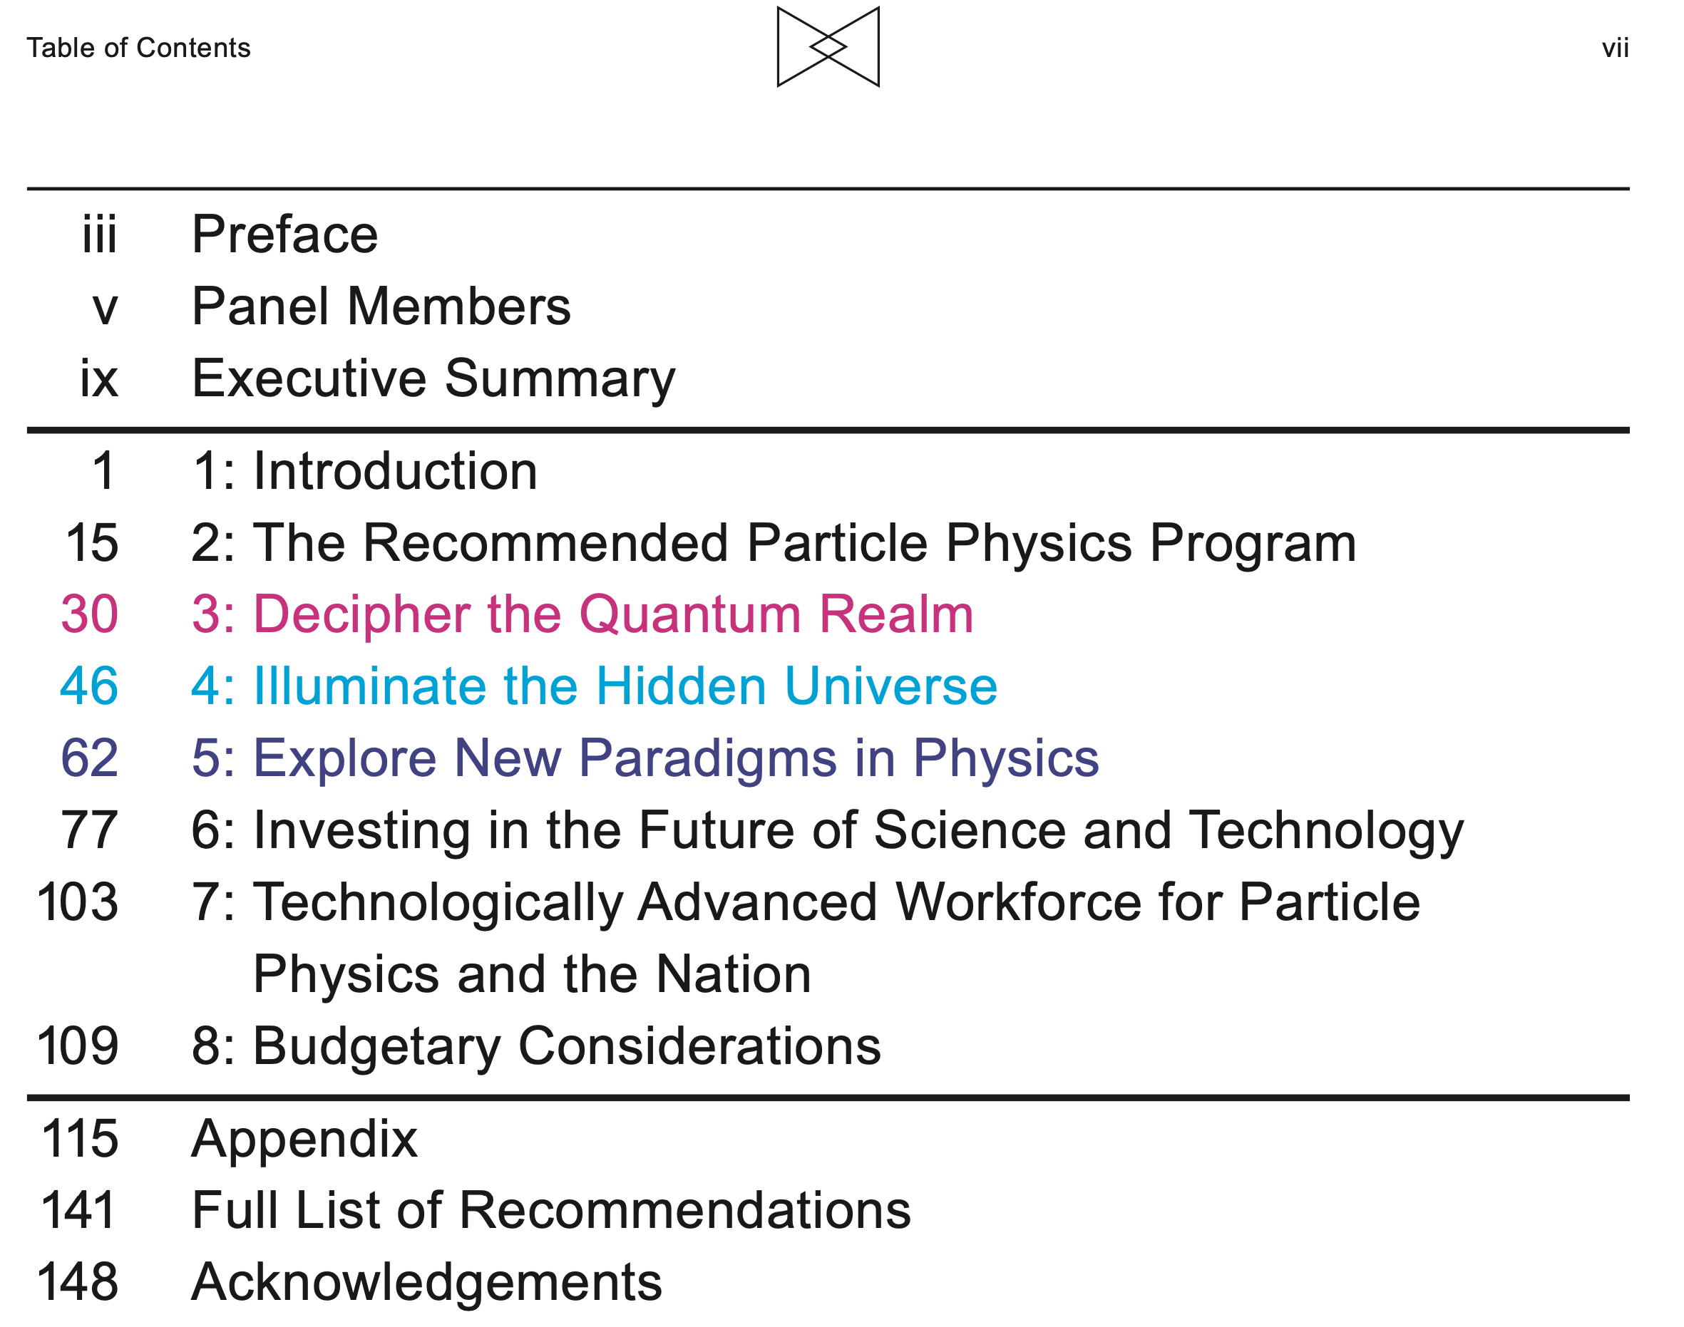

Slide 7
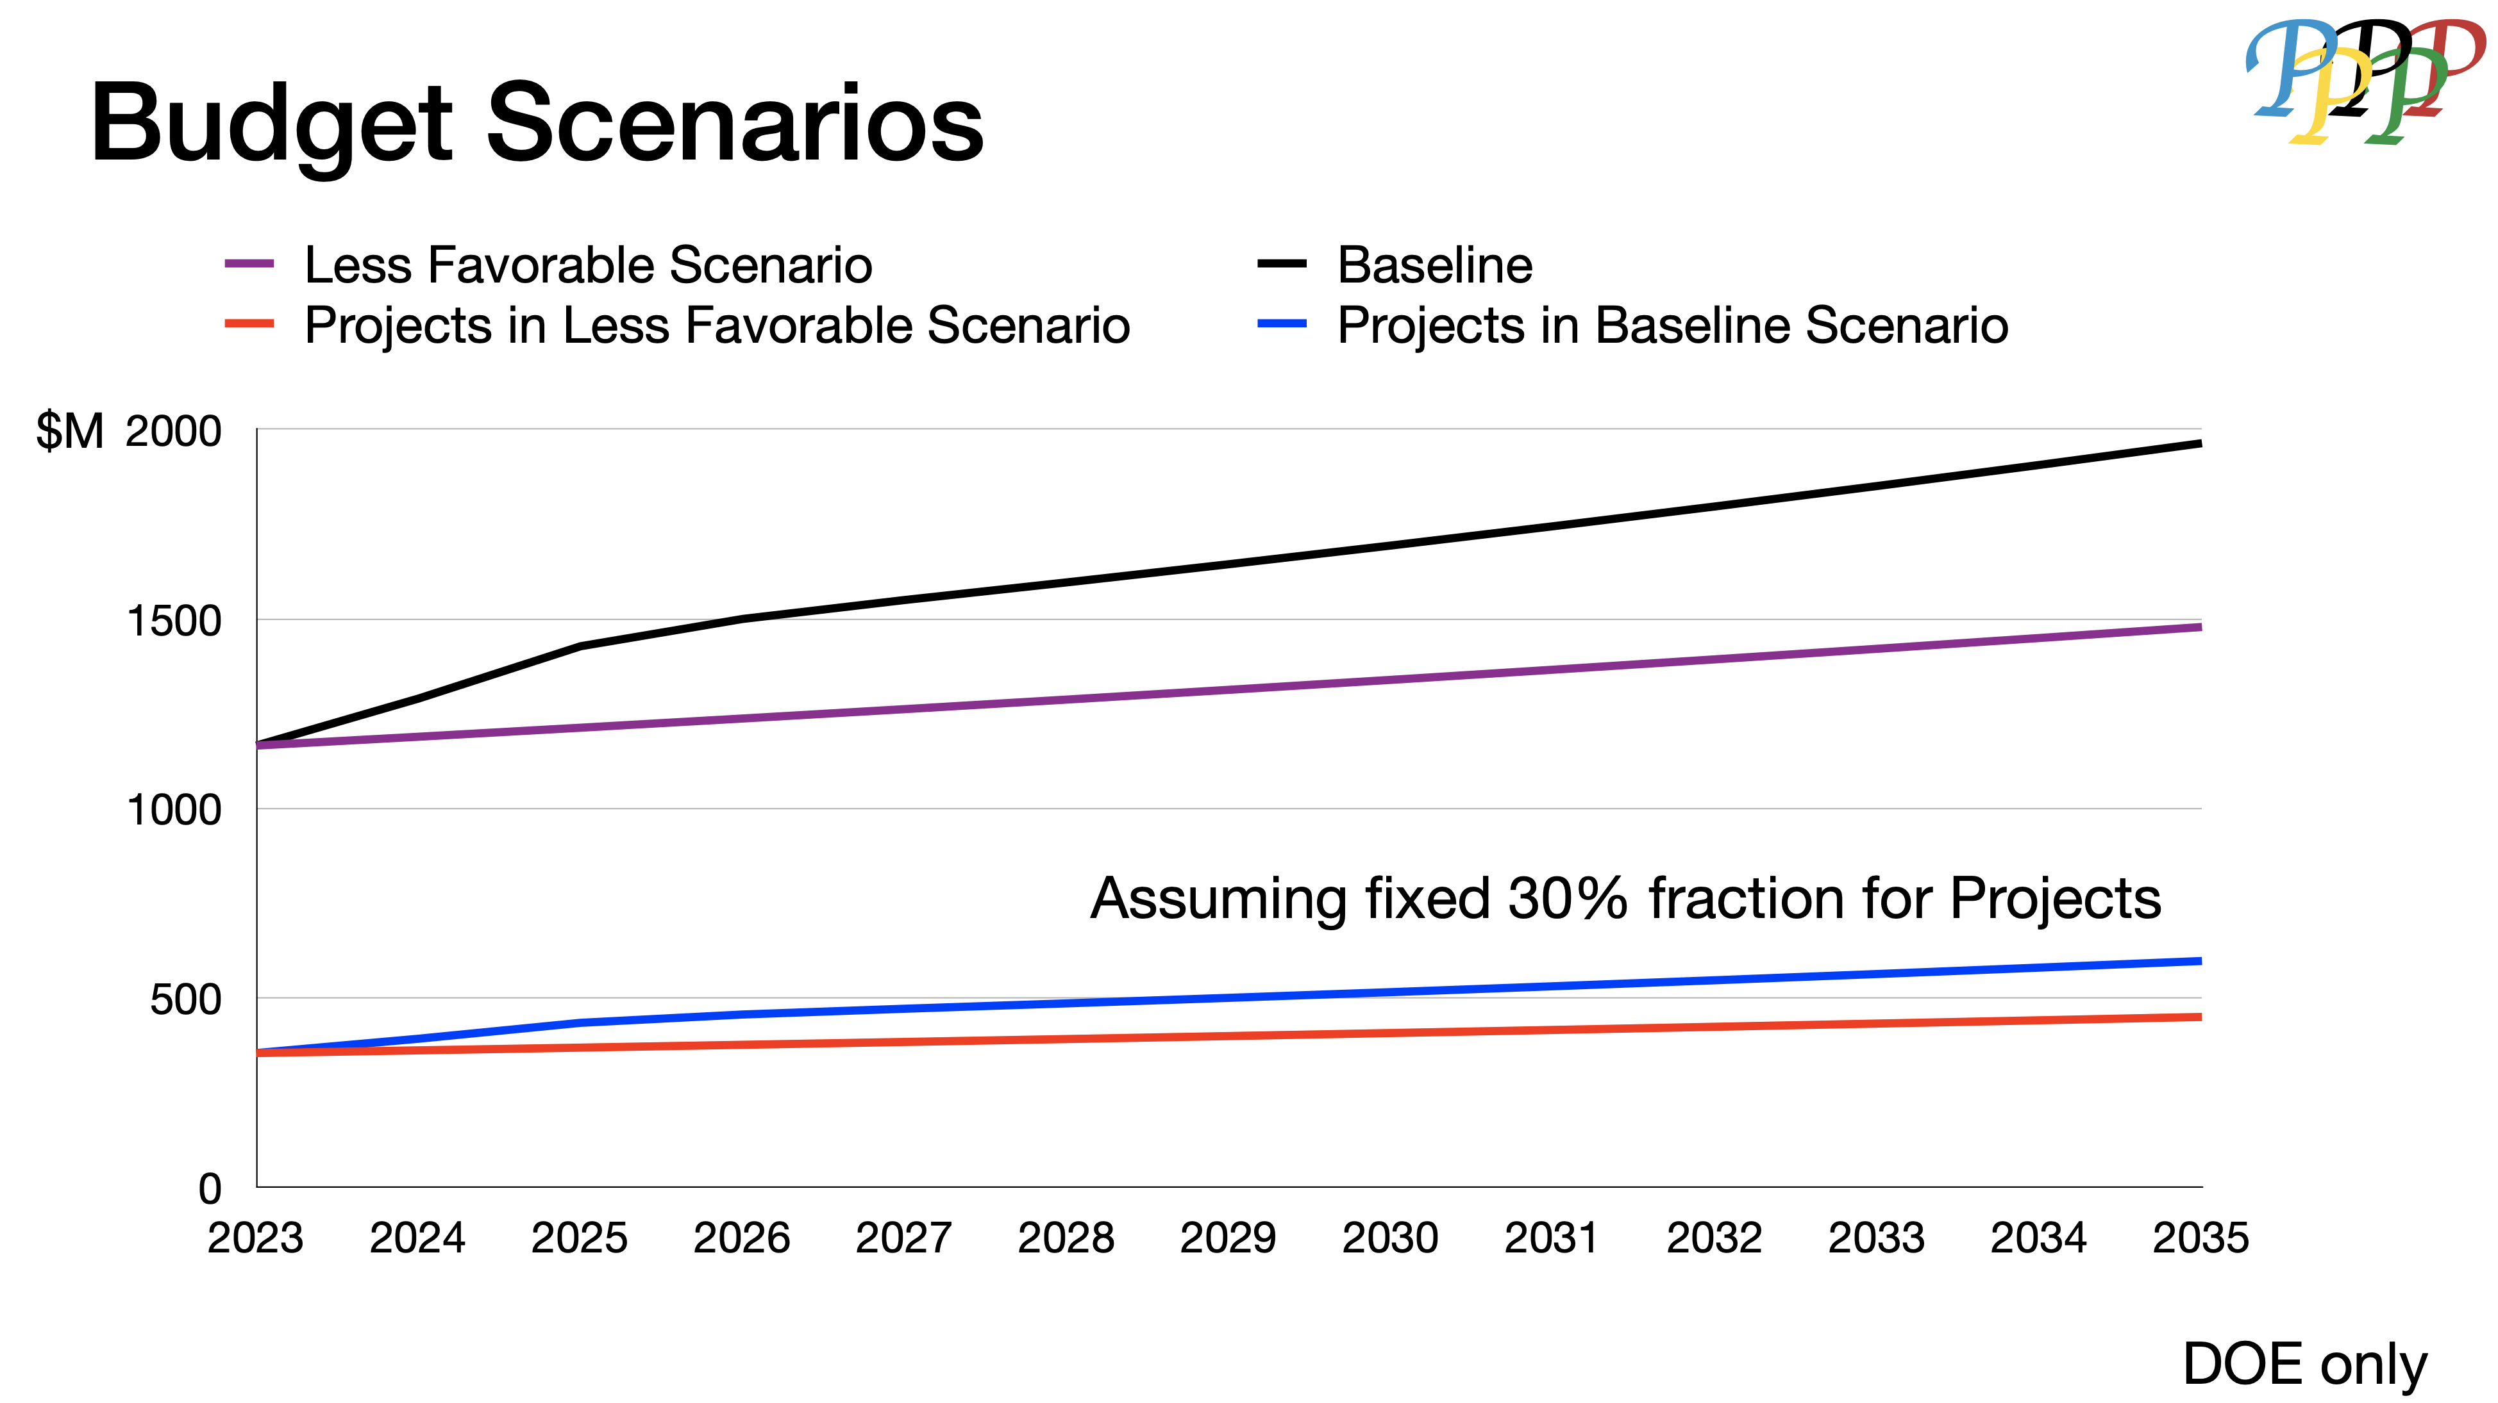
“The budget for the Department of Energy’s Office of Science, which includes funding for high energy physics, rose by 8% to $8.10 billion for fiscal year 2023.” (AIP via Bai). See chart below for HEP portion.
https://science.osti.gov/-/media/hep/hepap/pdf/Meetings/2023/P5-HEPAPv2.pdf
Prediction: The high technology industry will be a major source of funding for research and development that leverages point charge theory. The ROI will be large and the timelines shorter and more predictable.

Slide 8
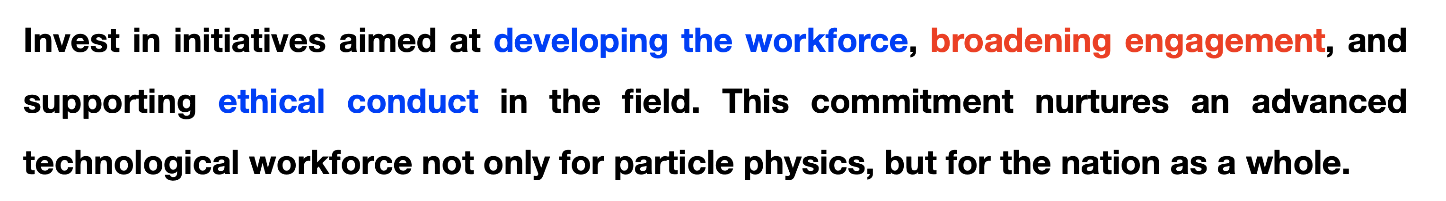
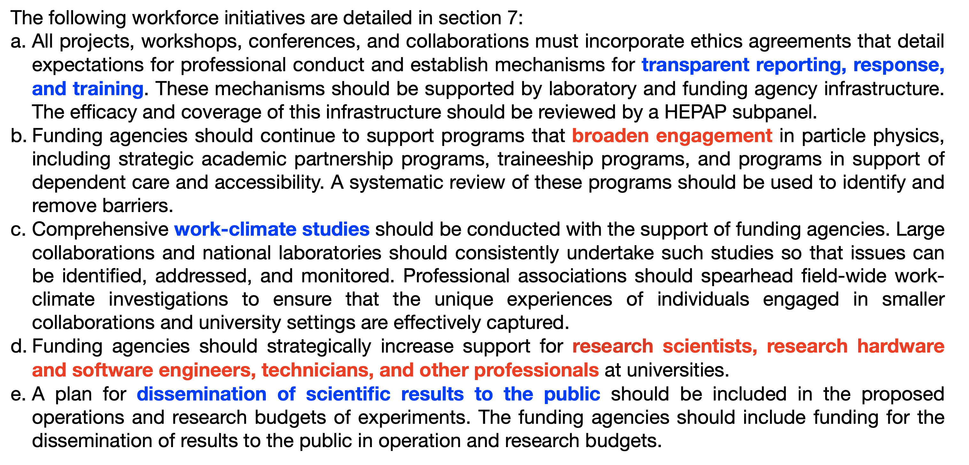
https://science.osti.gov/-/media/hep/hepap/pdf/Meetings/2023/P5-HEPAPv2.pdf

Slide 9
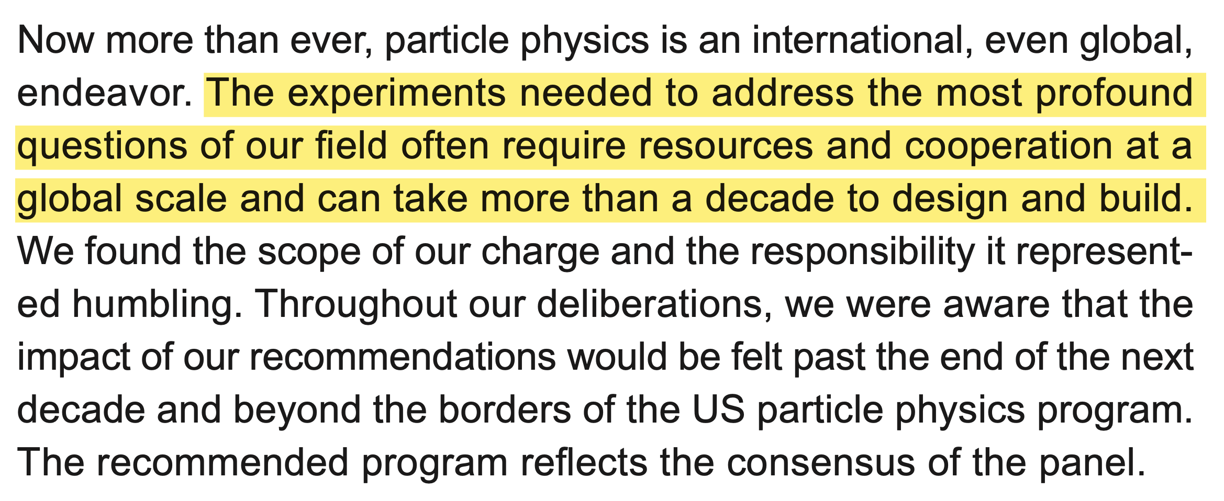

Slide 10
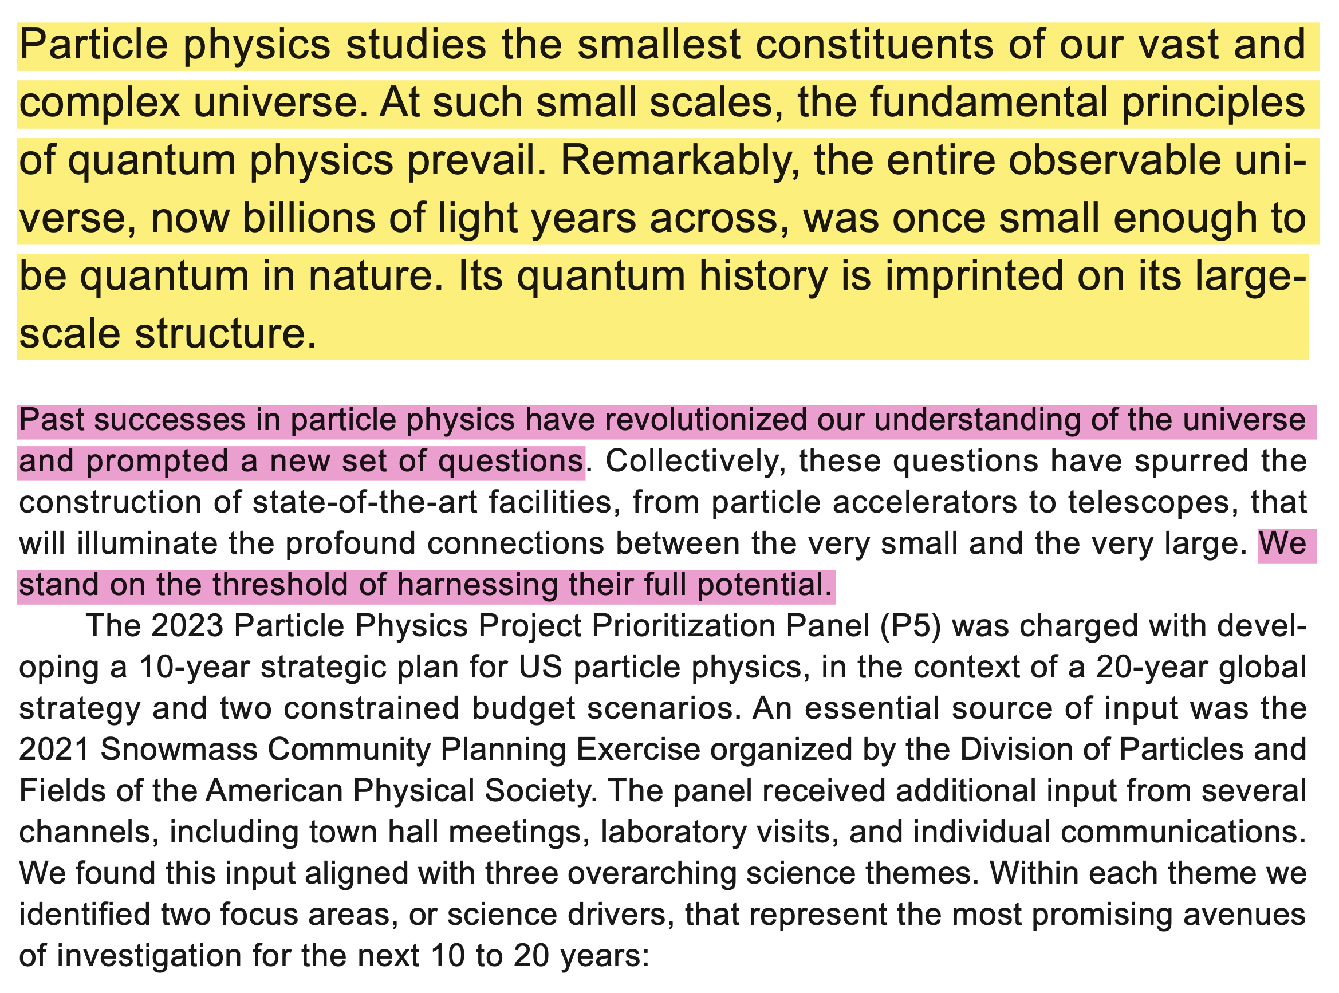

Slide 11
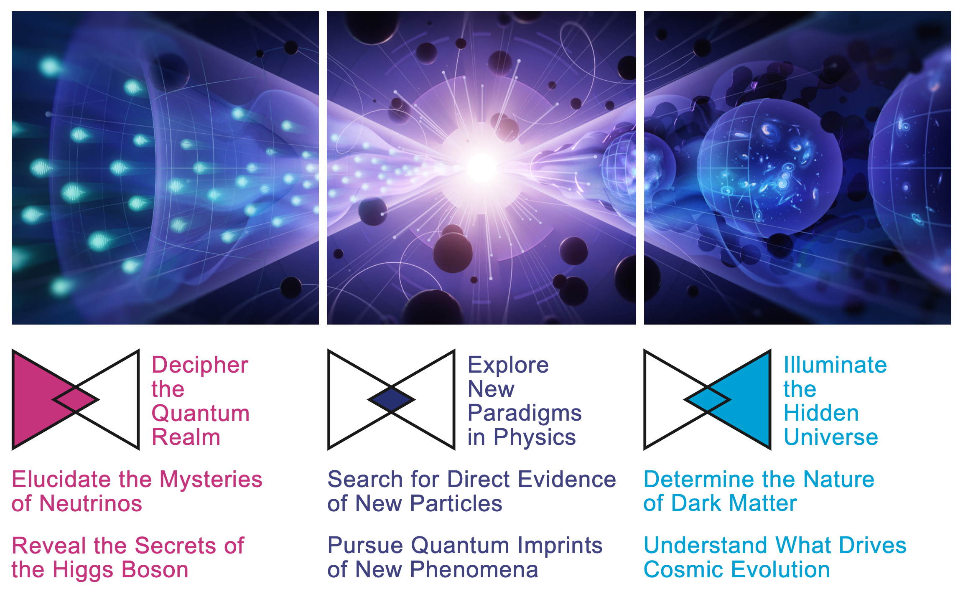

Slide 12
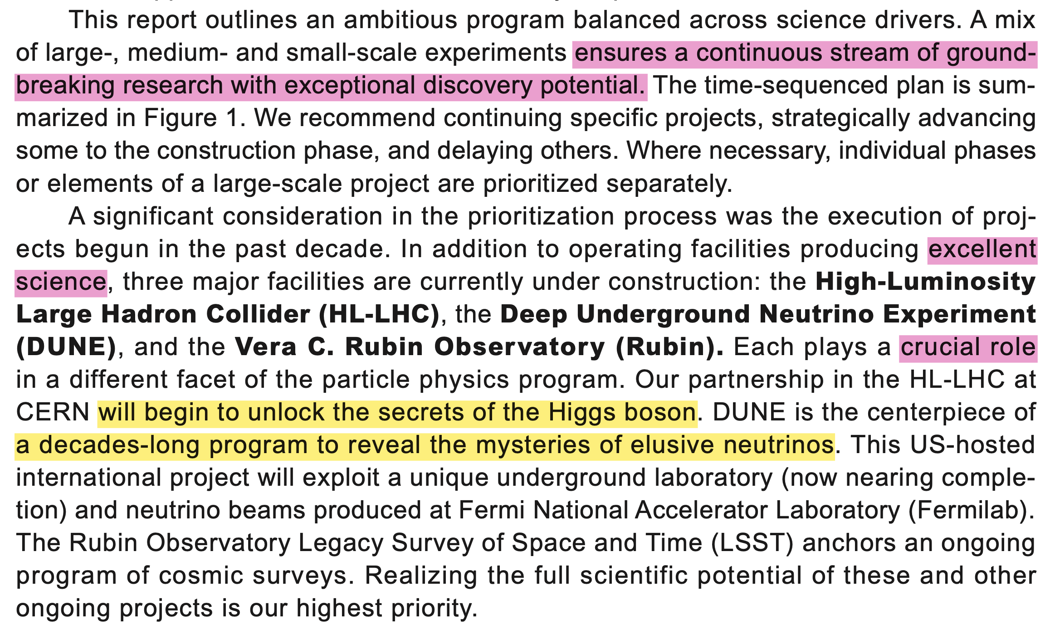

Slide 13
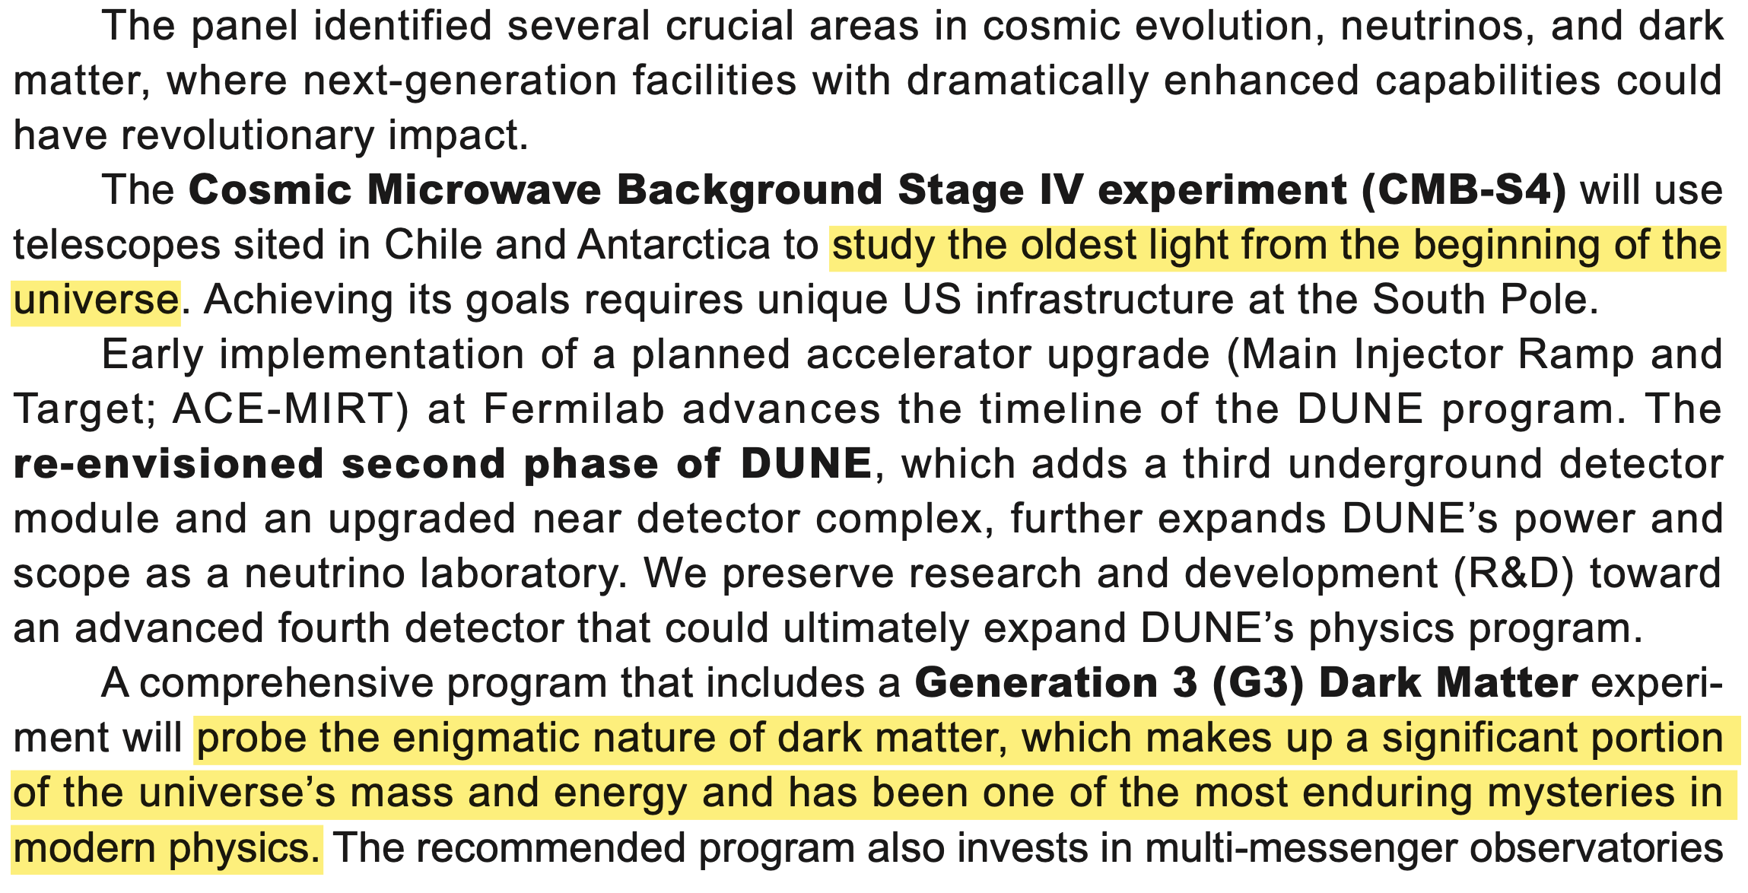

Slide 14
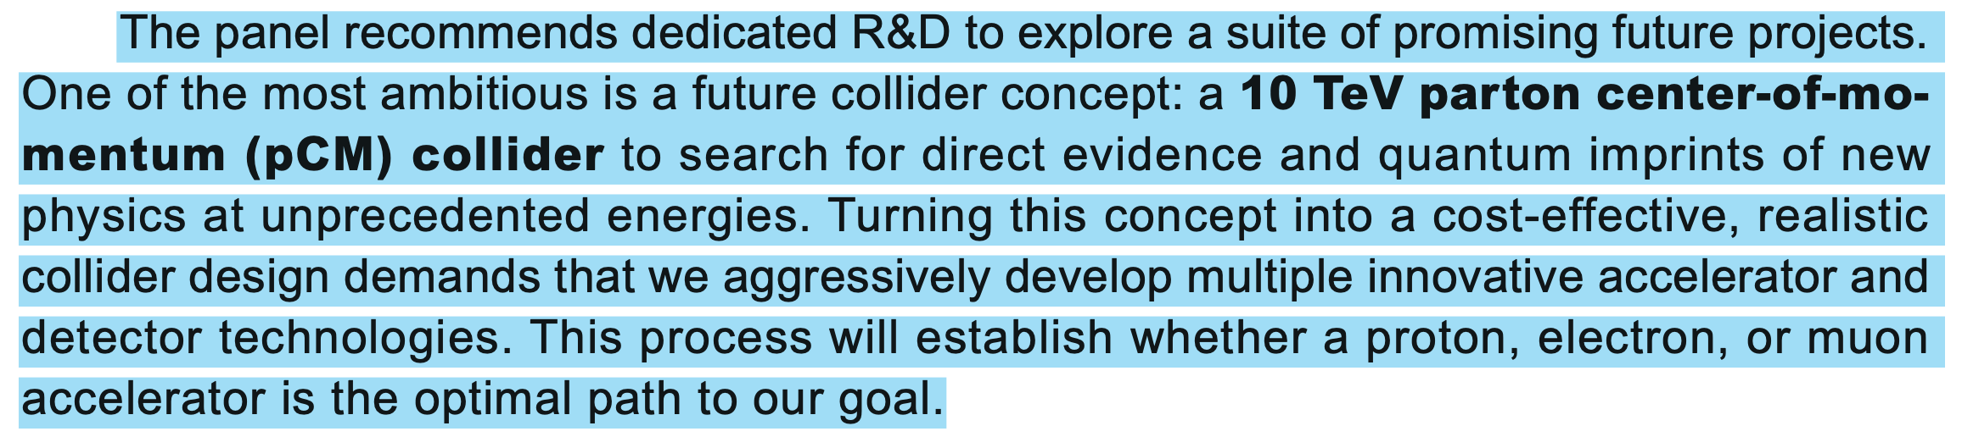

Slide 15
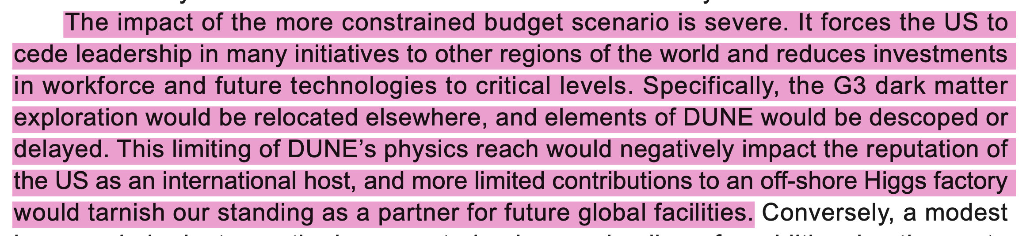

Slide 16
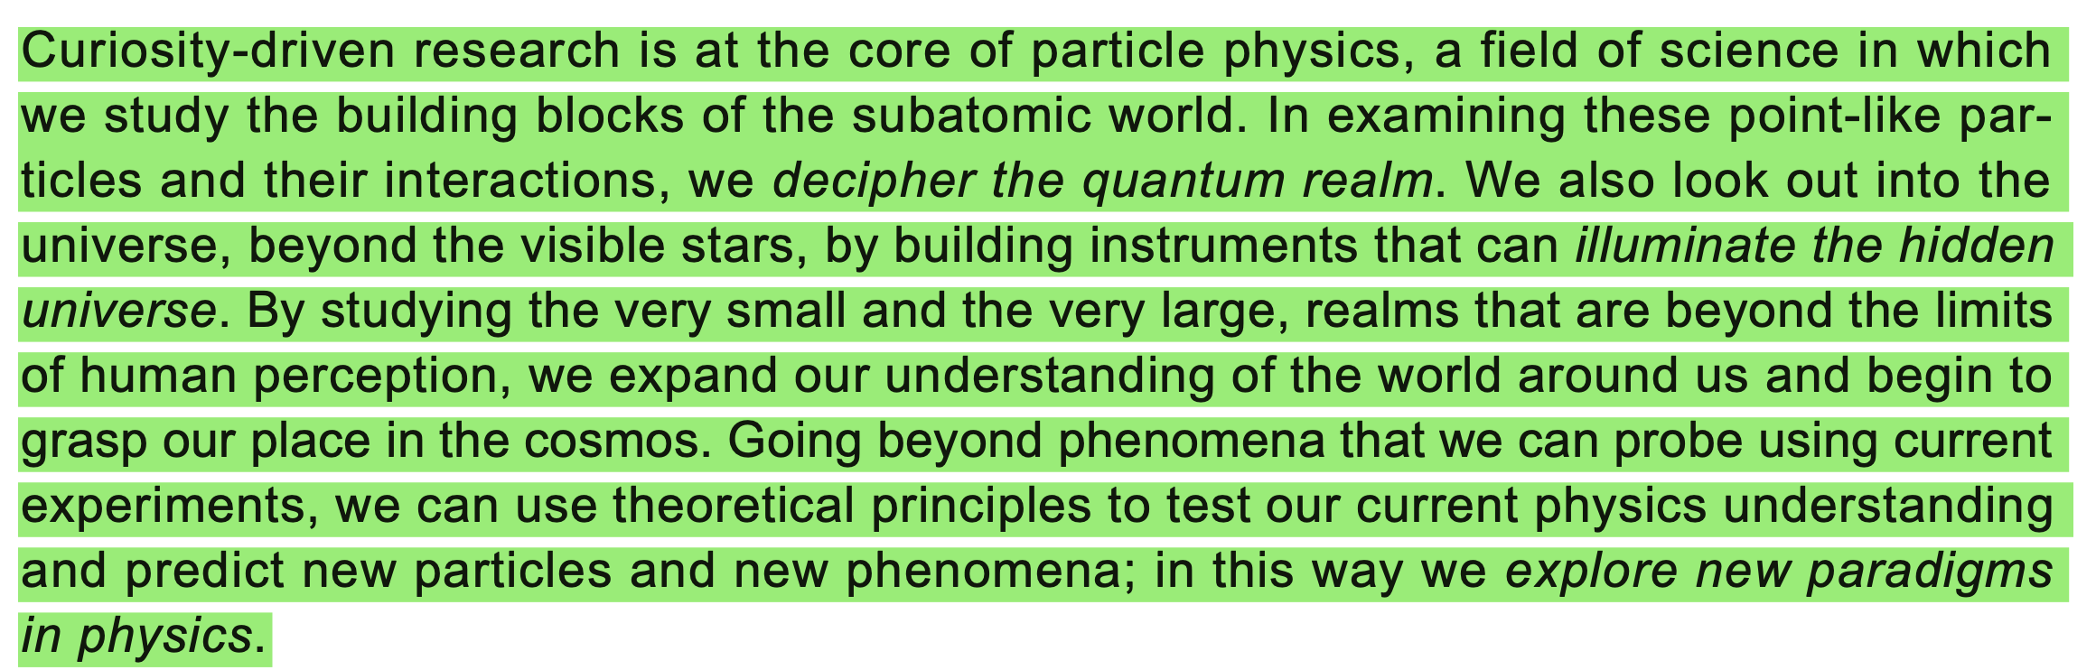

Slide 17
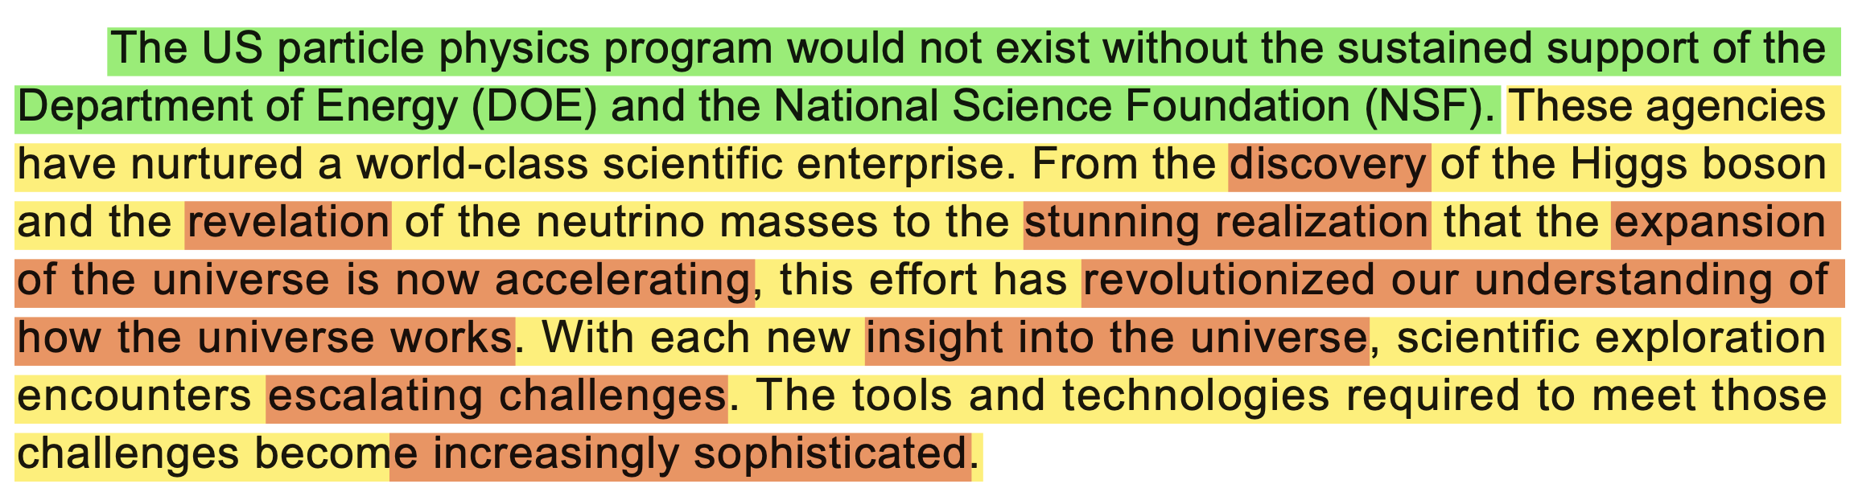

Slide 18
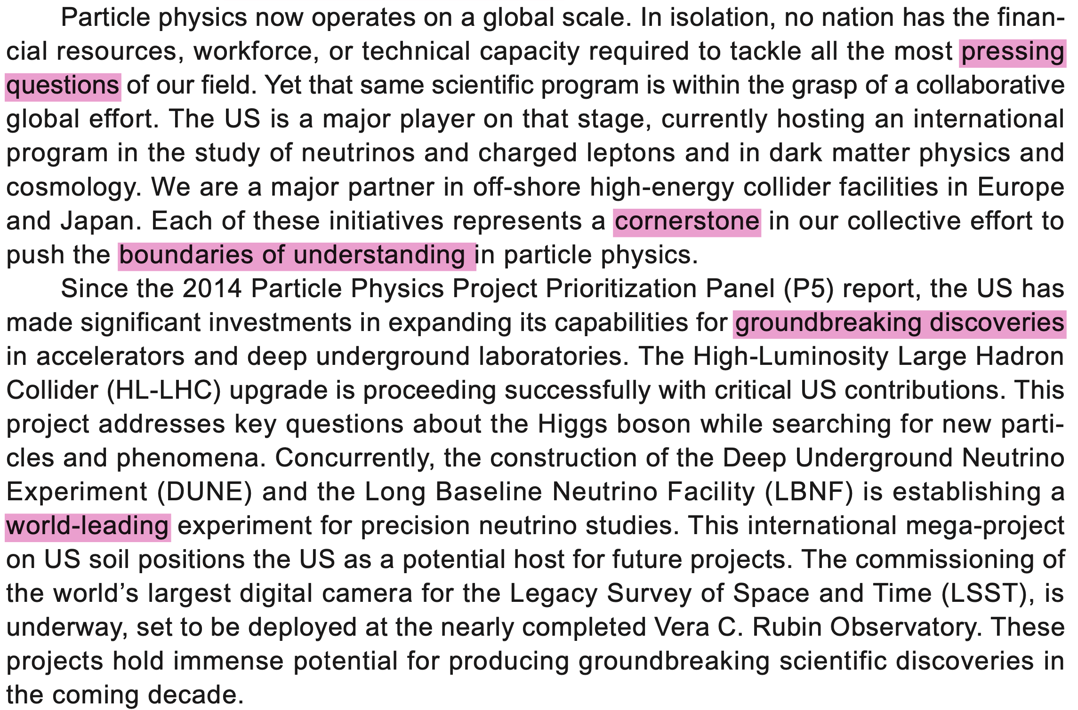

Slide 19
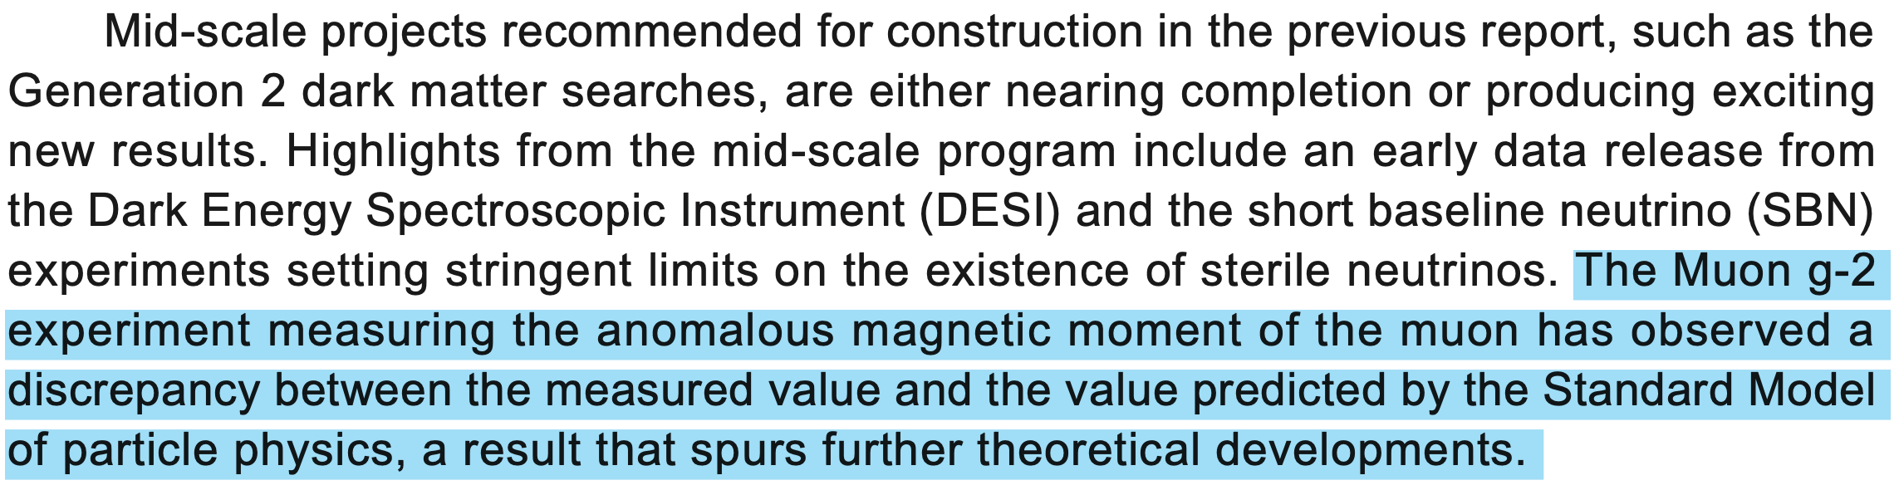

Slide 20
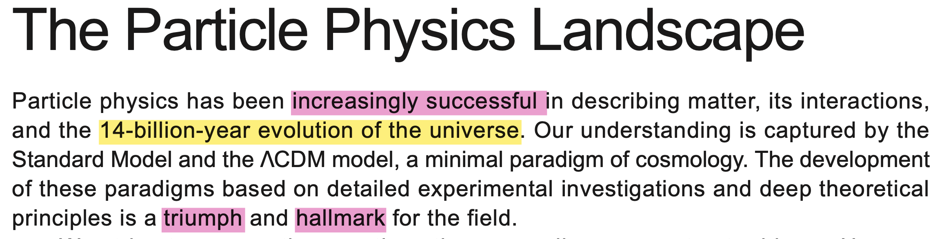

Slide 21
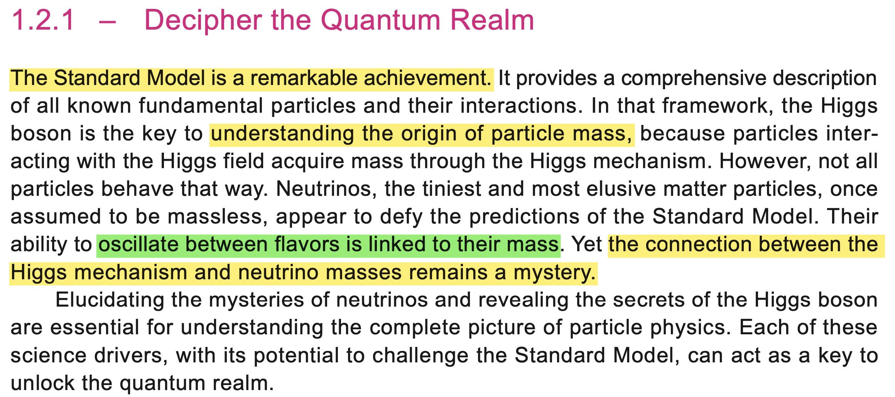

Slide 22
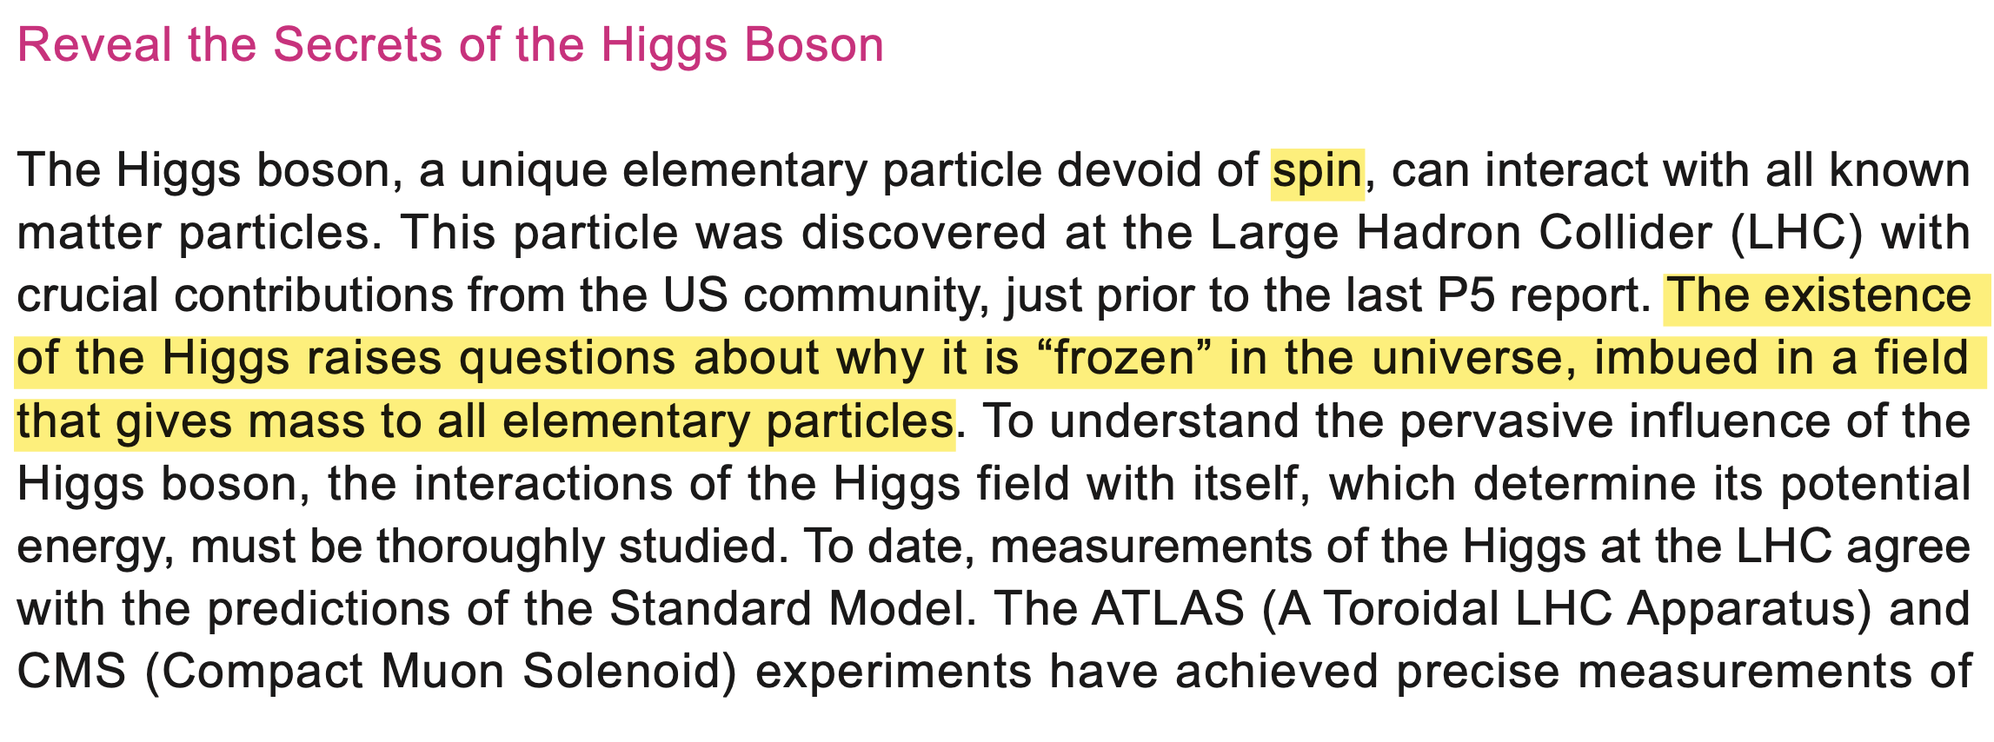
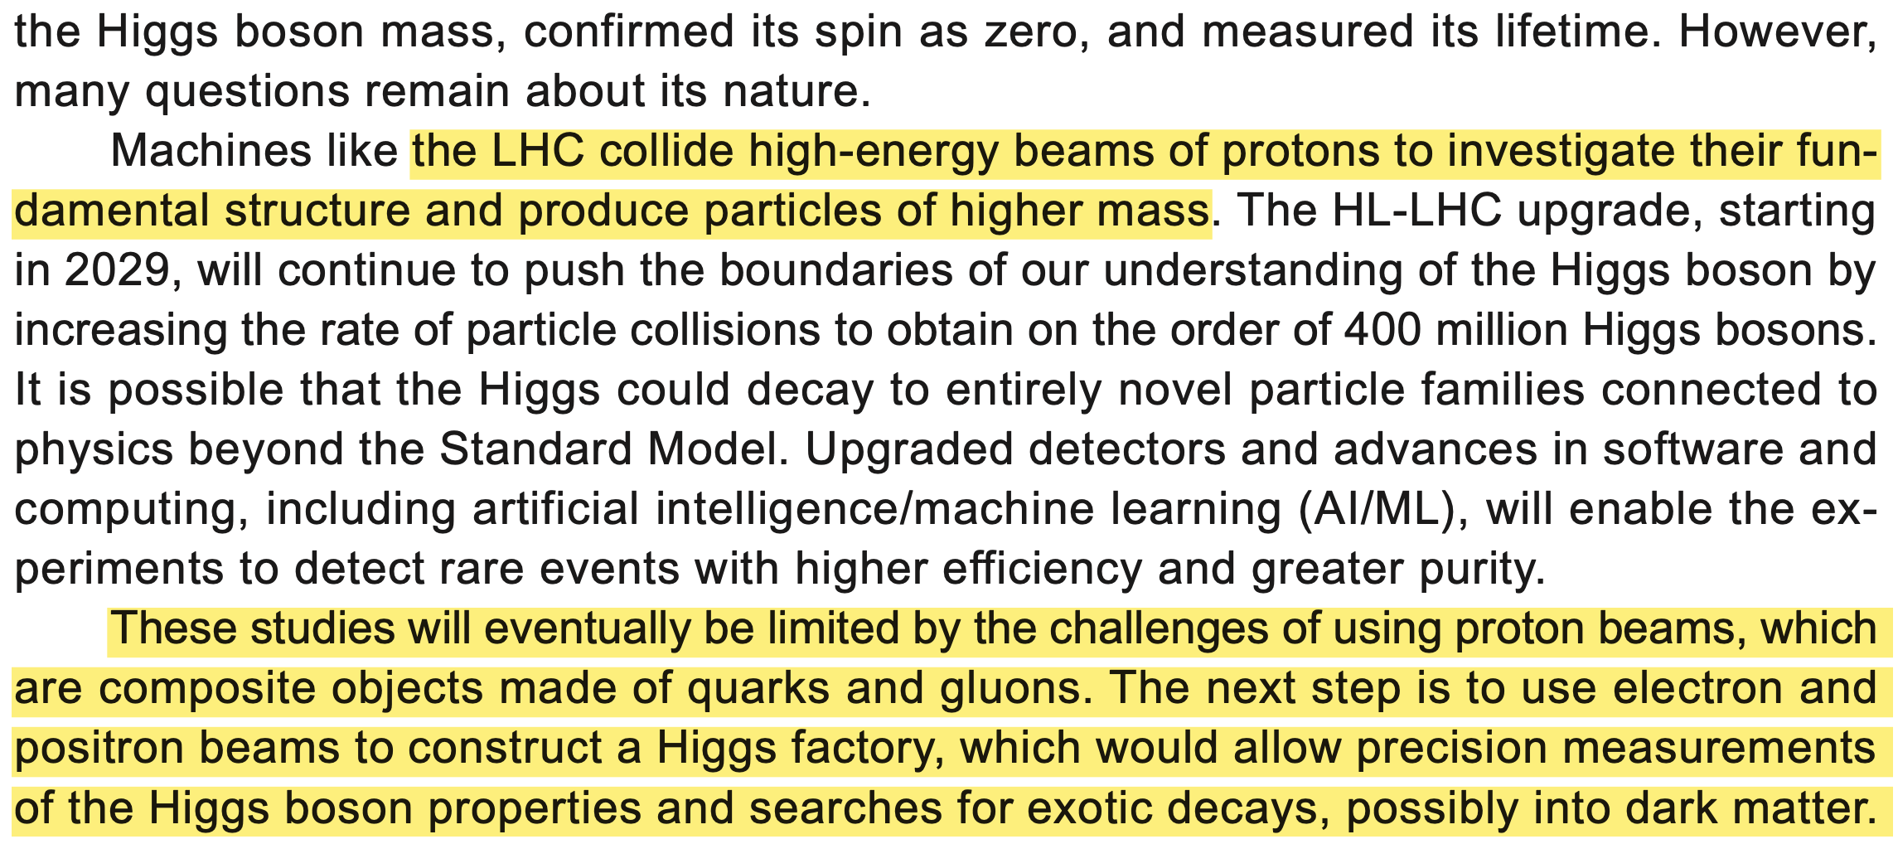
Notes:
show gluon
show proton components with animations

Slide 23
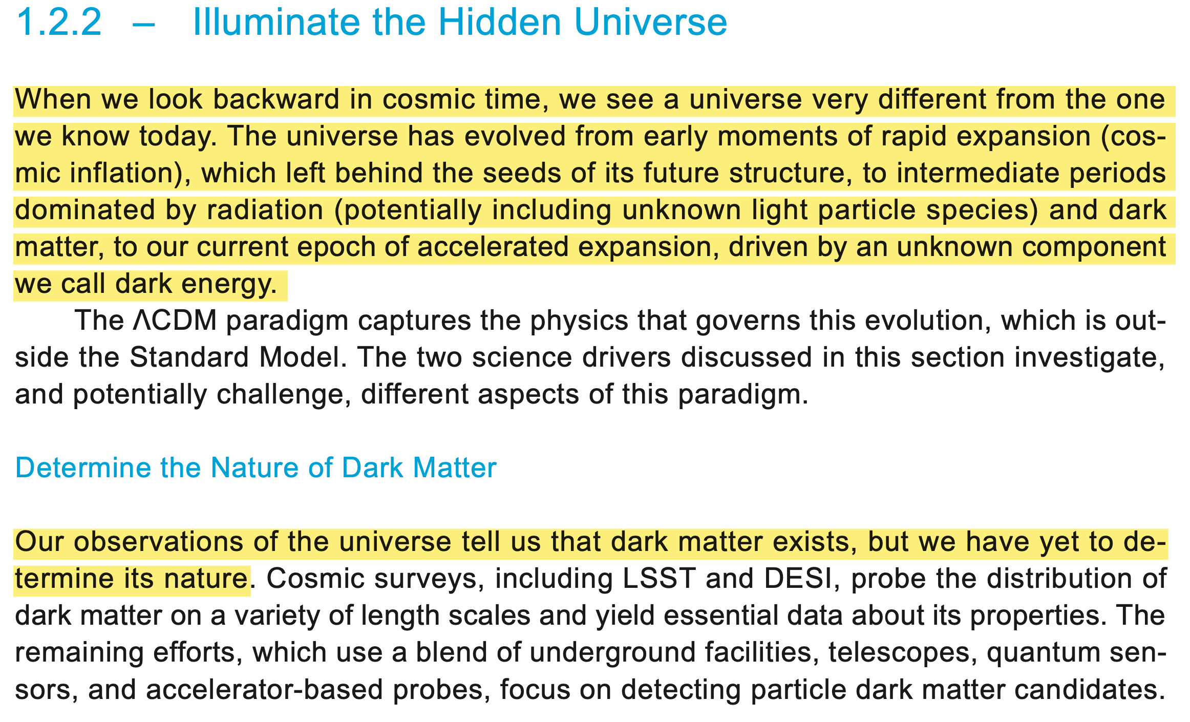

Slide 24
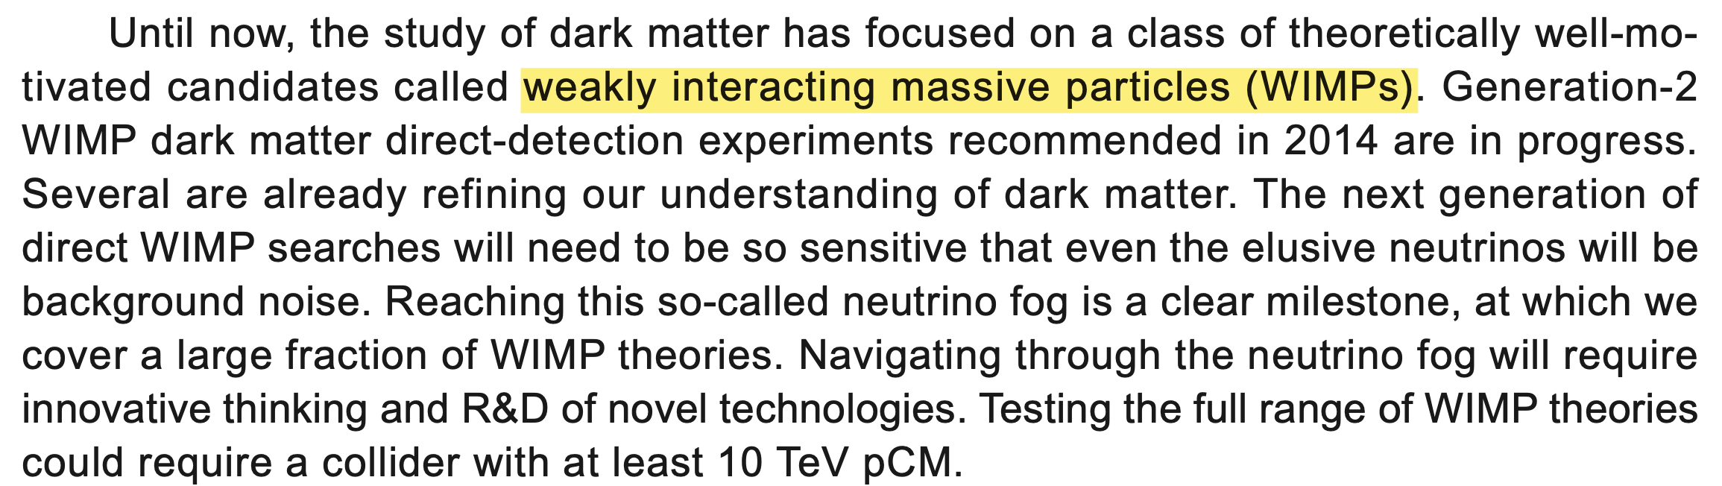

Slide 25
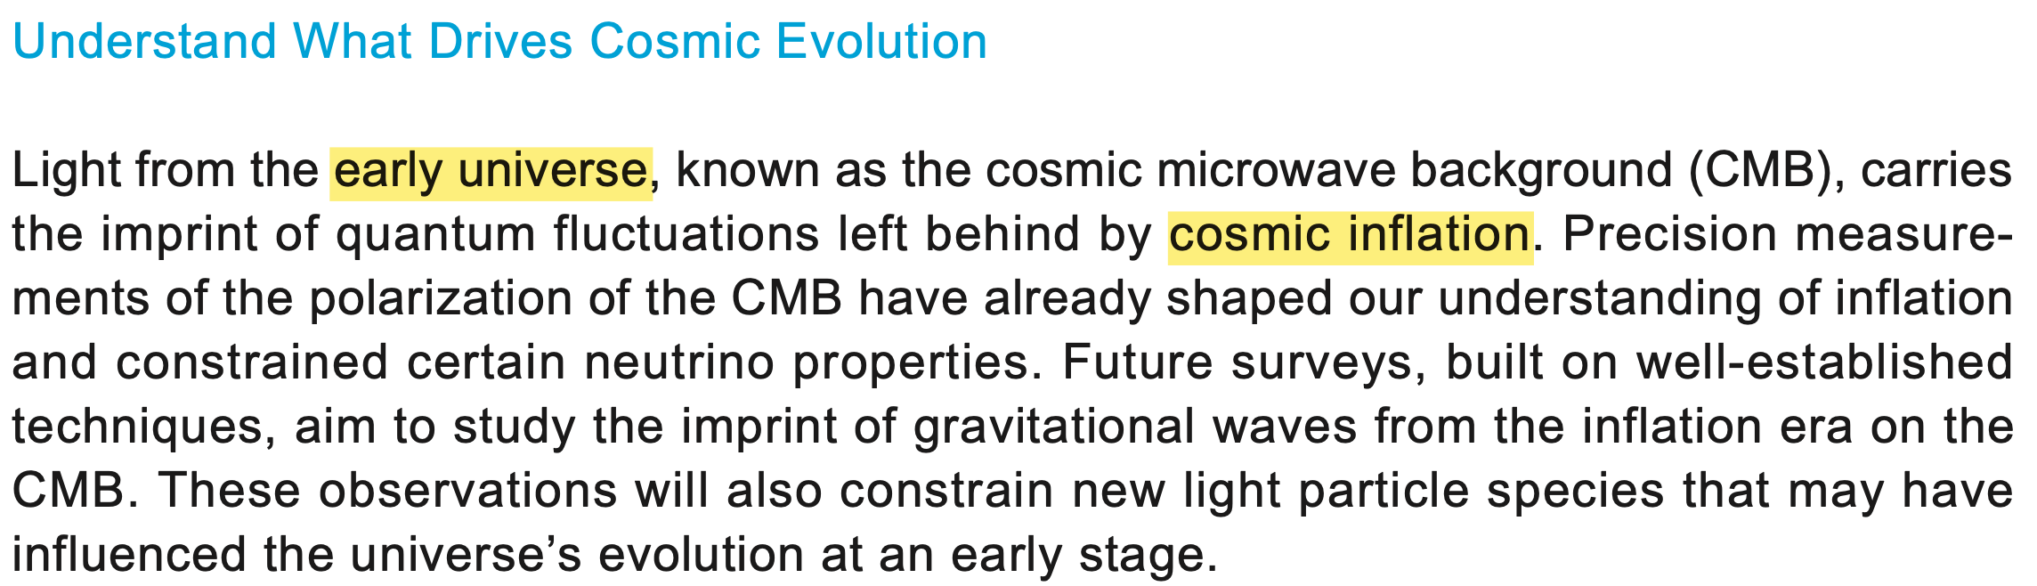
Notes:
good place to discuss the photon and it’s lifecycle

Slide 26
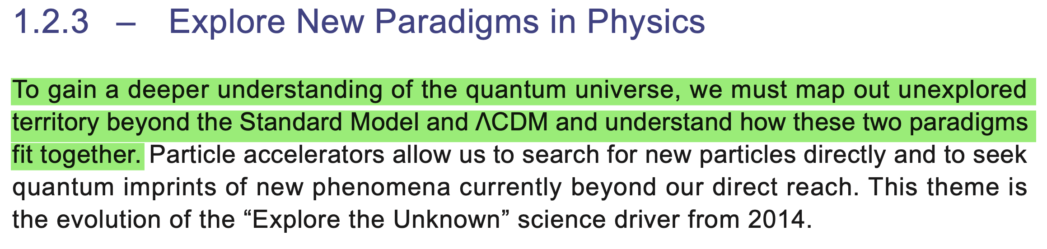

Slide 27
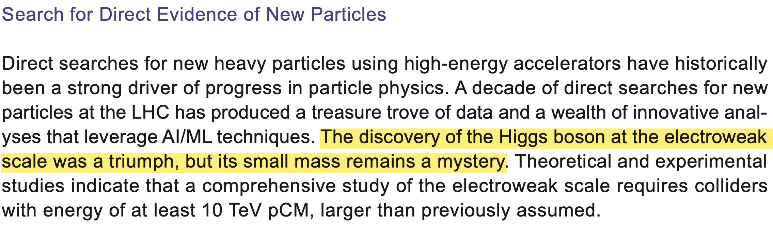

Slide 28
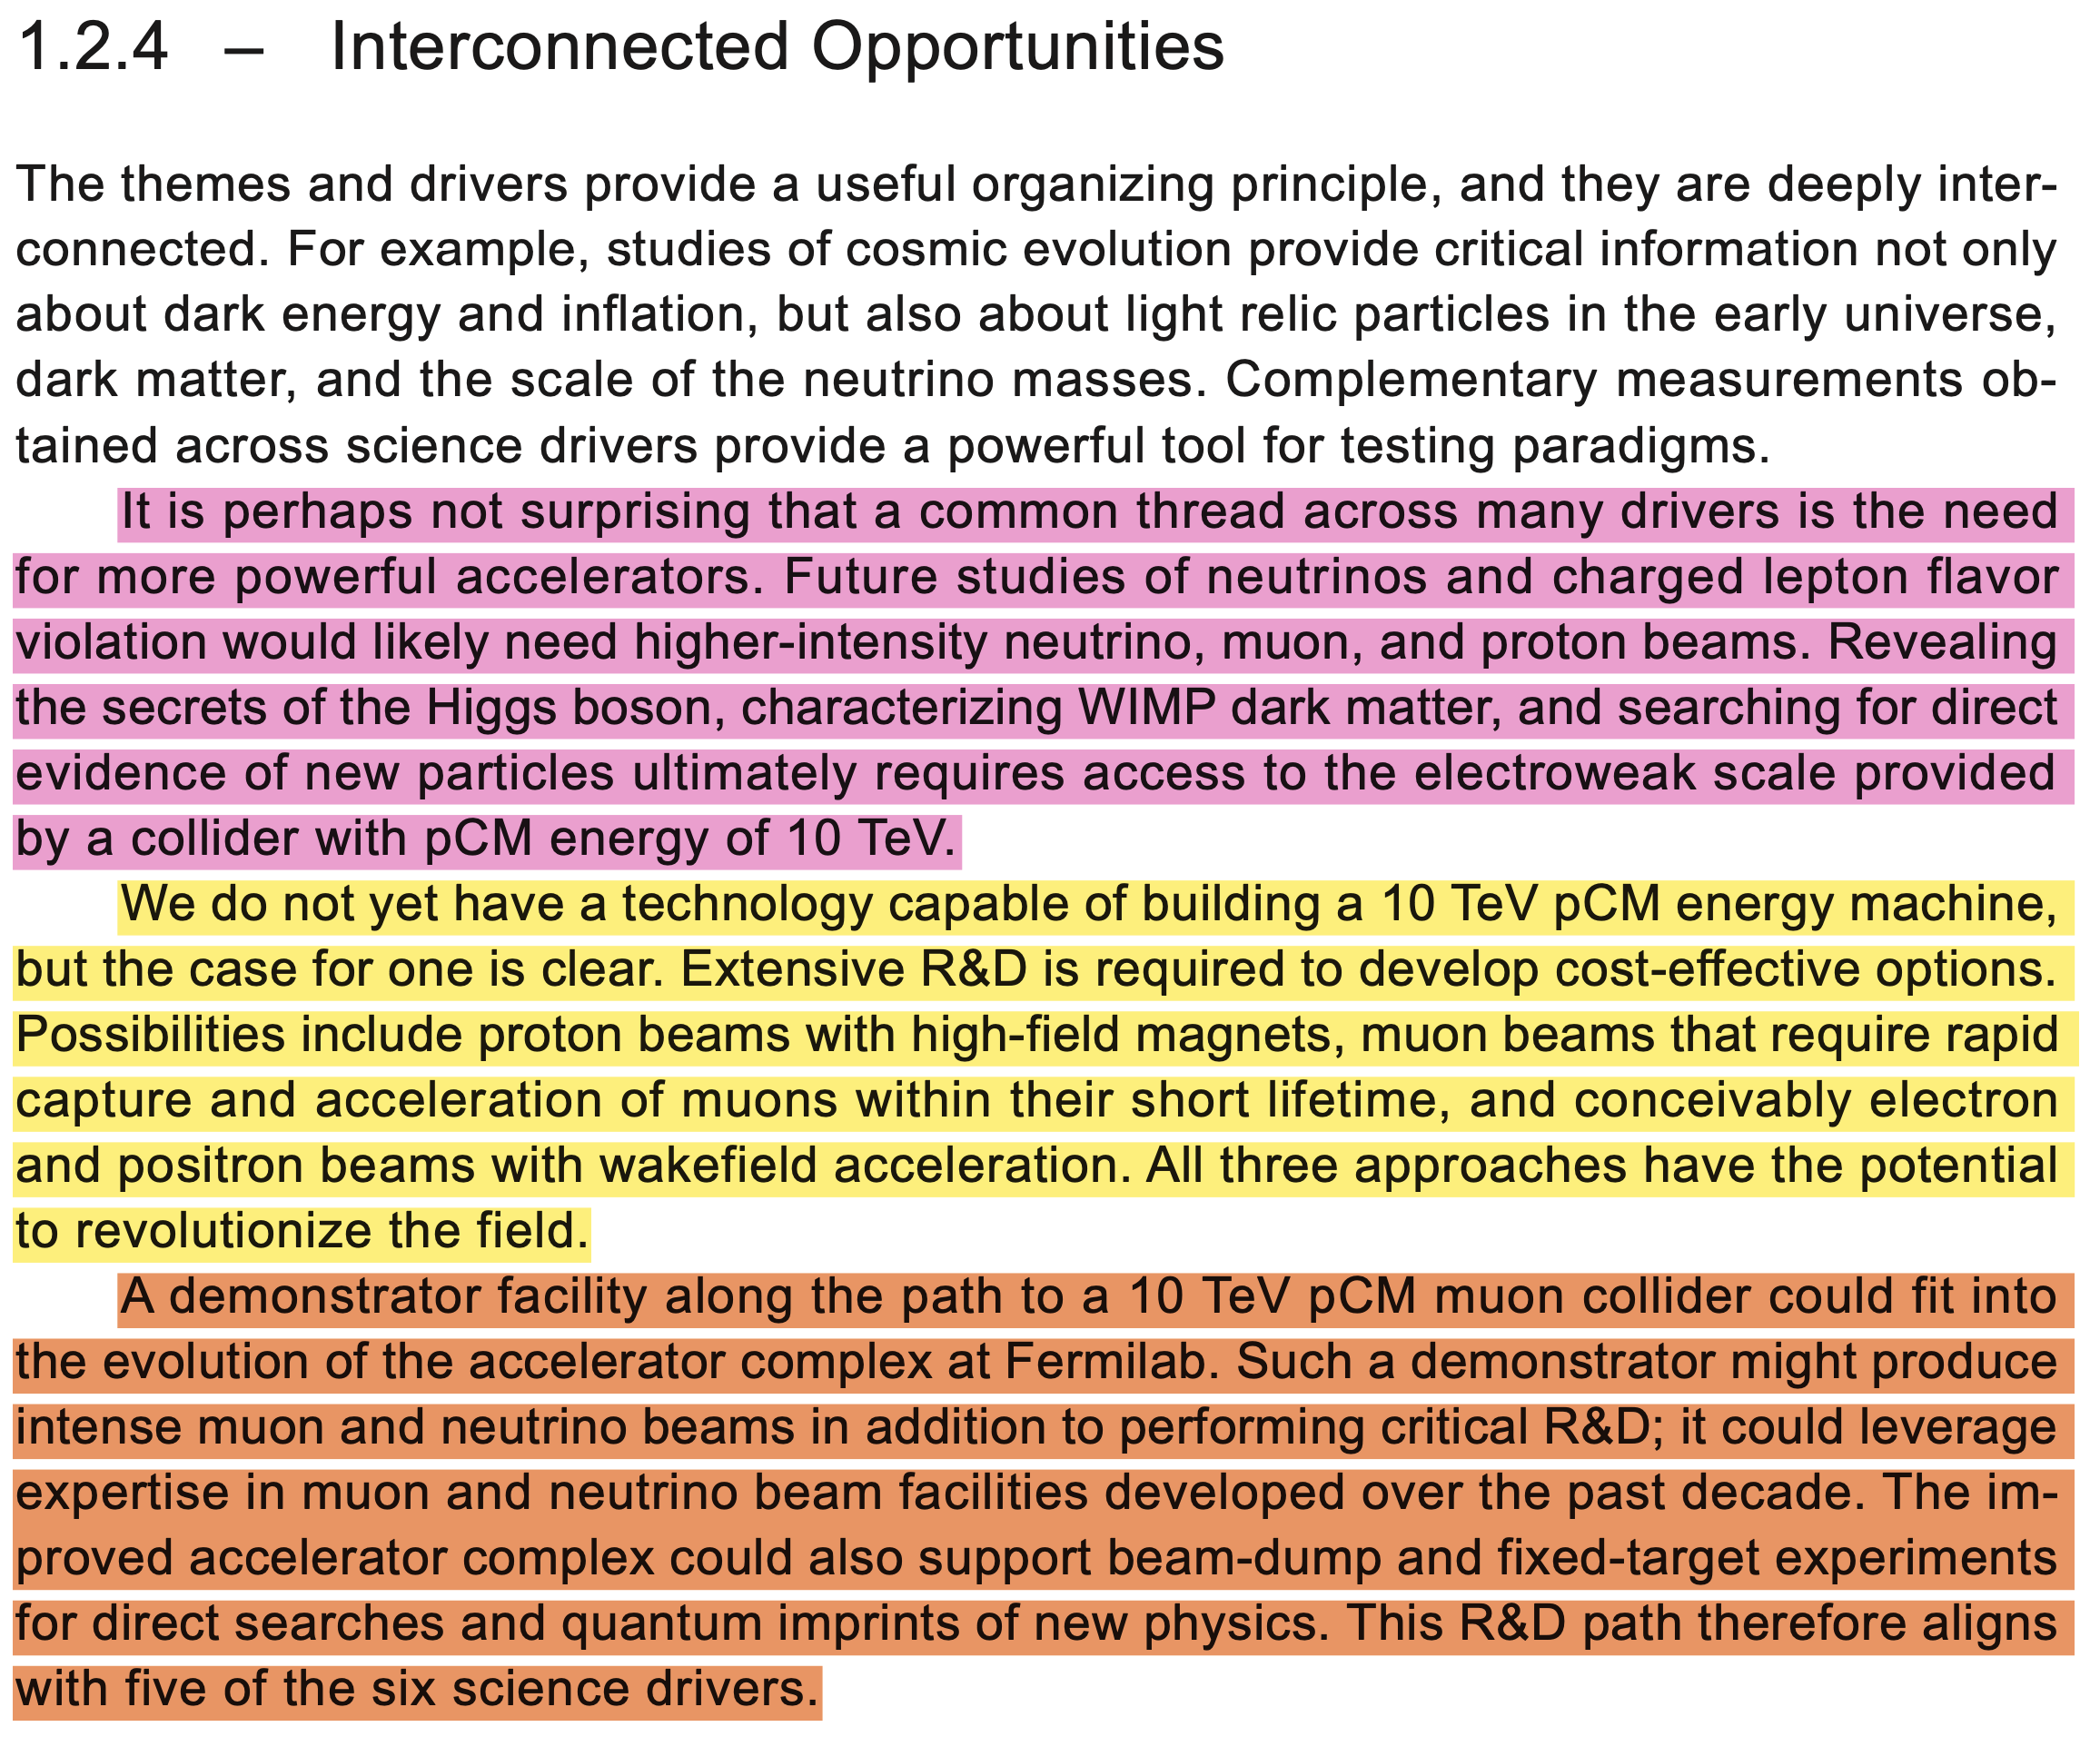

Slide 29
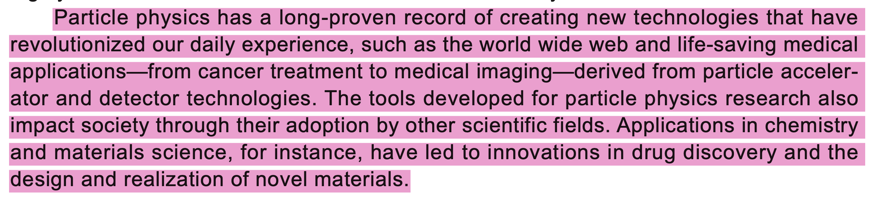

Slide 30
“It’s great if a field throws off new tangential technologies. However, if the field doesn’t make satisfactory progress on its main goals, offshoot technologies do not make the field successful.” J Mark Morris

Slide 31
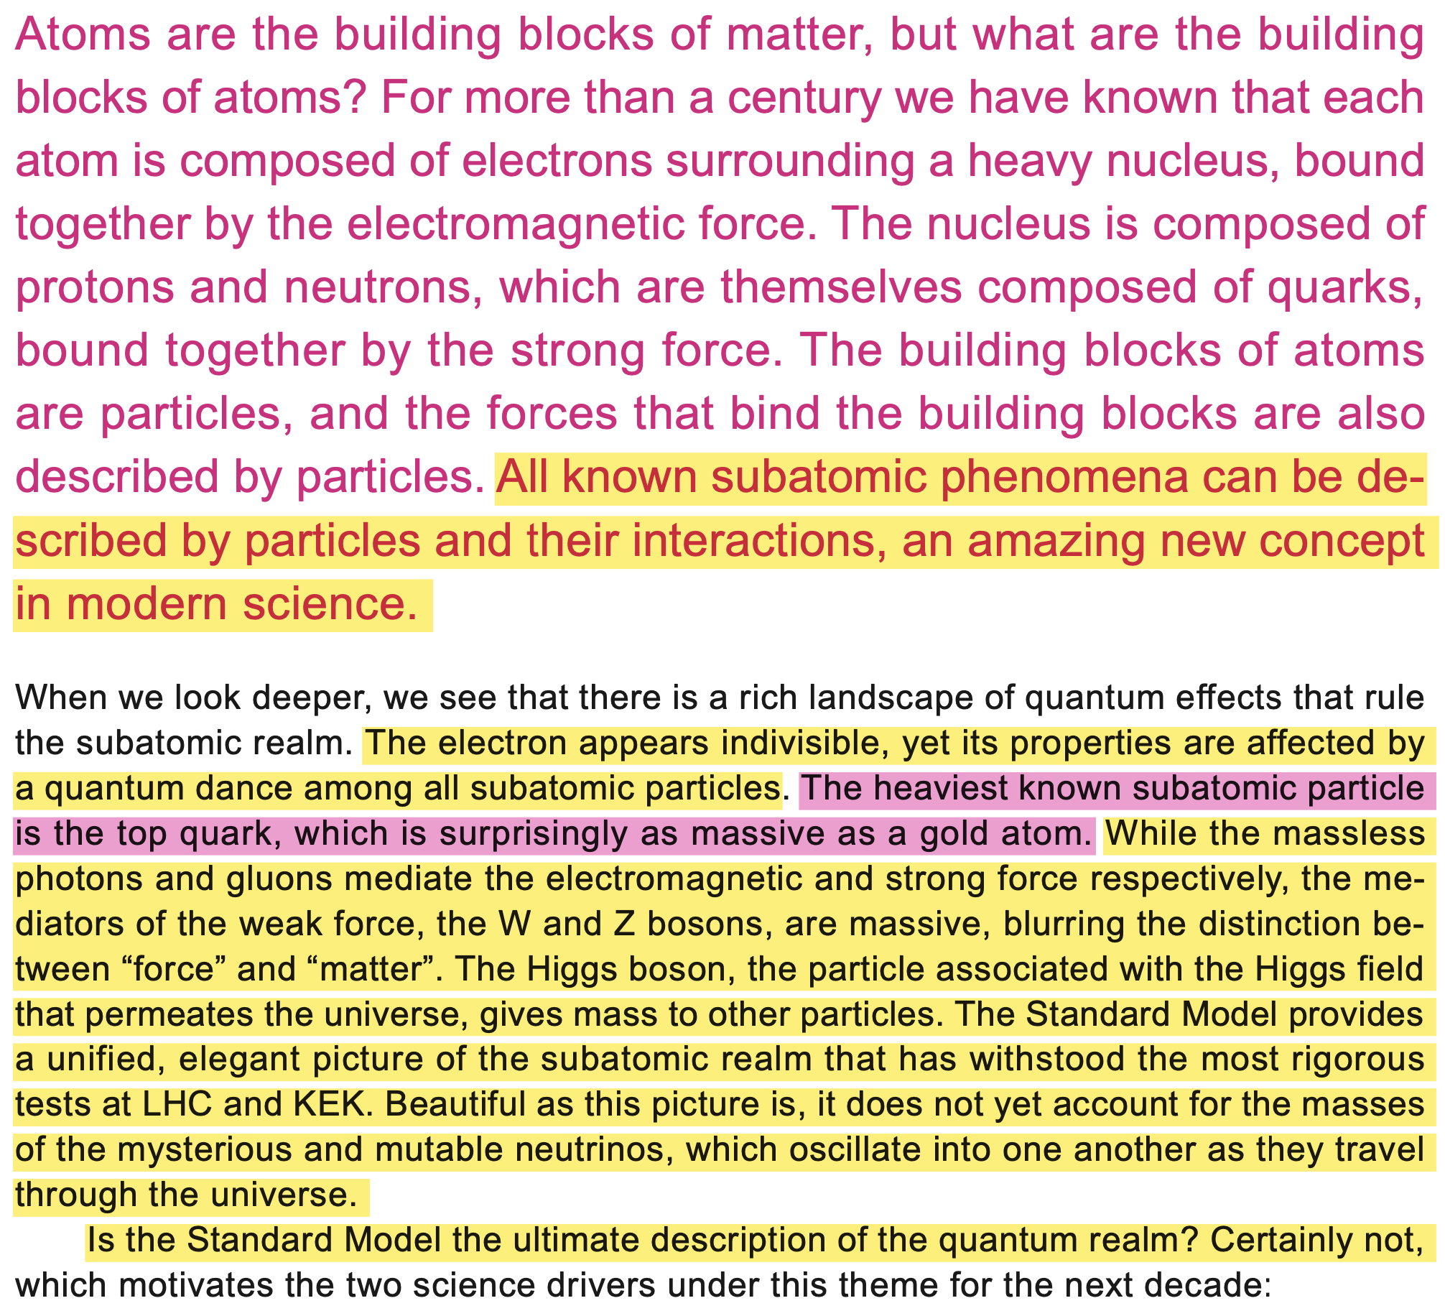

Slide 32
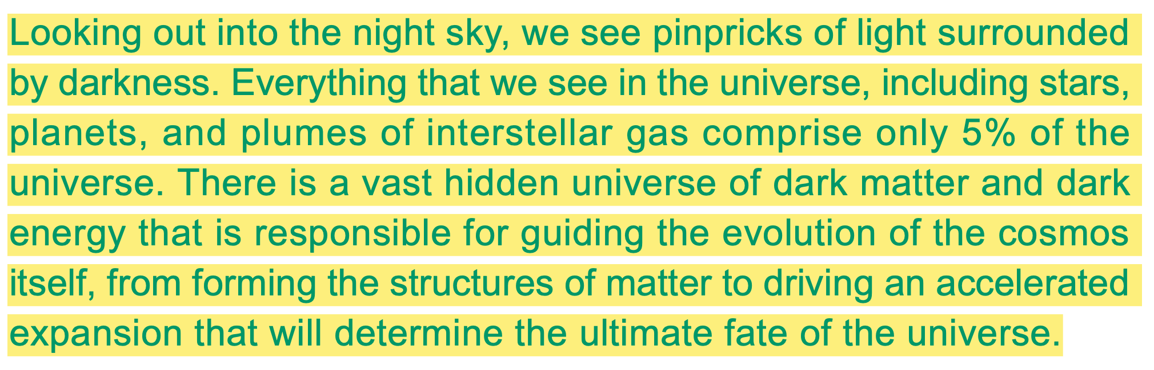

Slide 33
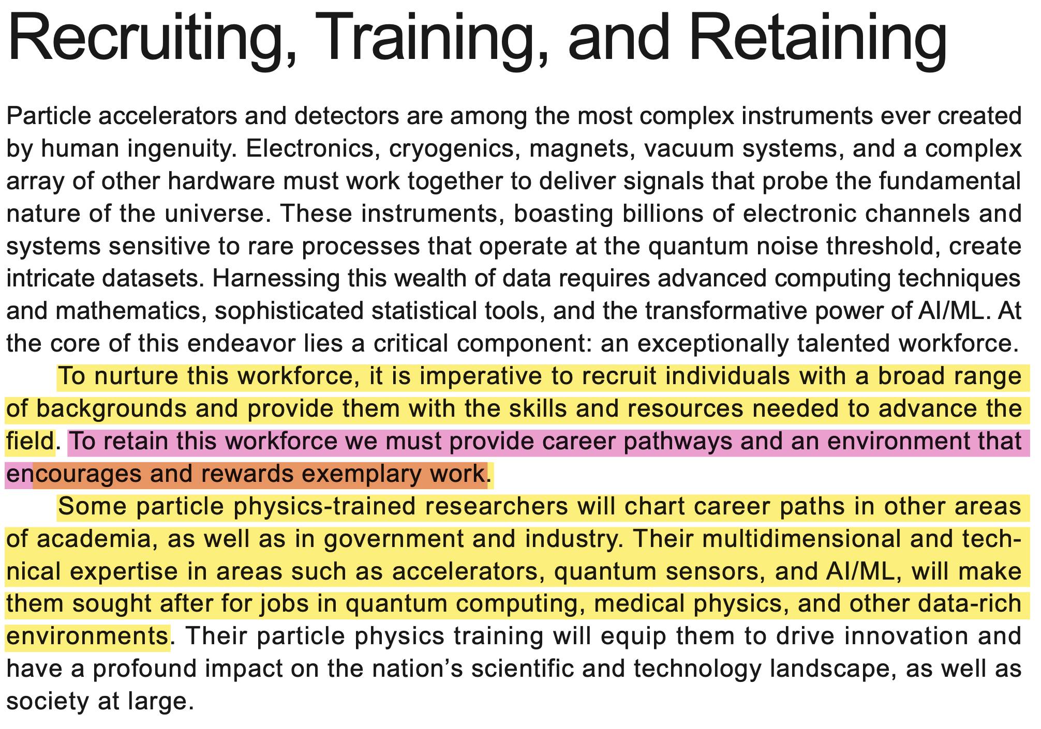
Notes:
field takes advantage of low cost labor from people with a passion for science

Slide 34
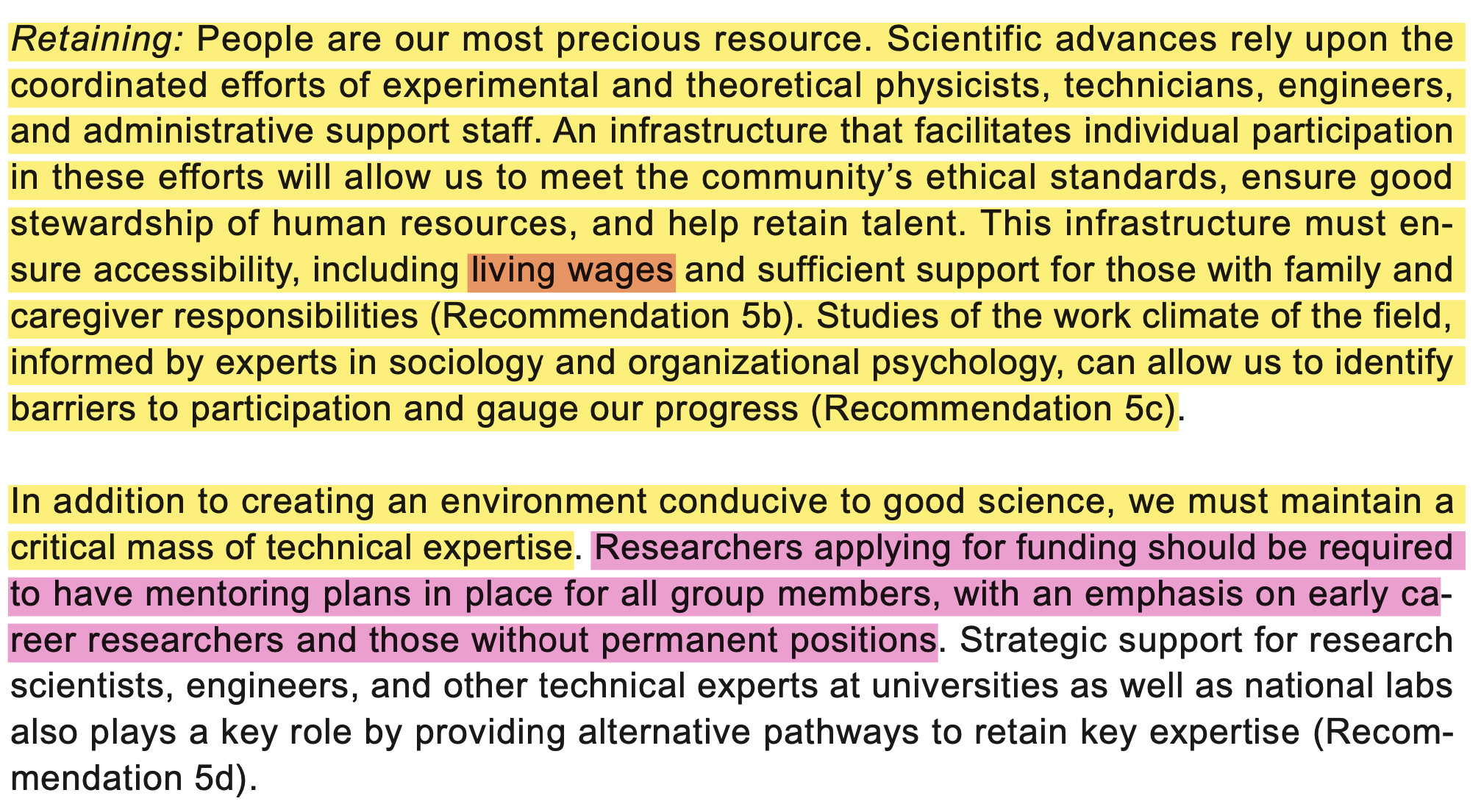

Slide 35
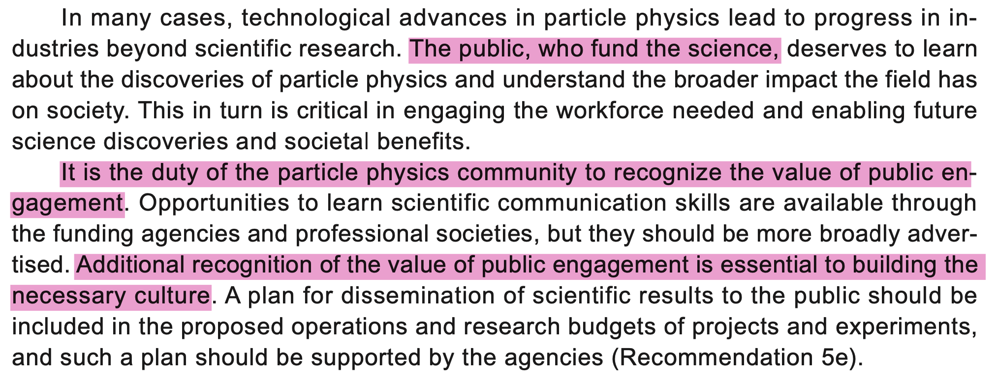

Slide 36
Recap and Recommendations
The fields of particle physics and cosmology require a tear down and a rebuild from the new foundation of the point charge era.
The transitional period will be difficult for many people in the field.
The good news:
The fields will be a lot more productive going forward
The future pathway for research and technology will be abundantly clear.
Fundamental research will require a shift of resources into simulation.
Existing physical facilities and experiments may have some use in test and verification. However, this will need to be assessed. There may be far less expensive paths forward.
Technology investors will offer lucrative R&D positions to people who quickly become experts in the point charge model of nature.

Slide 37
Thank You
Questions?

